Slide 1
Overview of Project Labor Agreements
SMART-SMACNA
July 10, 2023

Slide 2
SMART-SMACNA’s PLA Webinar
The webinar is divided into two parts, with Part 1 presenting an overview of PLA basics.
Part 2 will cover:
The use of PLAs on projects funded under recent federal legislation
Updates on requirements in notices of funding opportunities (NOFO’s) of key federal agencies
The final regulations implementing President’s Biden Executive Order on PLAs (not yet issued)

Slide 3
Part 1: PLA Basics

Slide 4
What is a Project Labor Agreement?
A PLA is a comprehensive “pre-hire” collective bargaining agreement that applies to one or more construction project(s) for the entire length of the project(s).
PLAs commonly incorporate the CBAs of the local unions.
PLAs are project-specific.
Private and public projects (federal, state, and local)
Local Building Trades Councils often negotiate PLAs on behalf of local affiliates based on models produced by NABTU.

Slide 5
Pre-Hire Agreements
Since PLAs are 8(f) “pre-hire” agreements under the National Labor Relations Act (NLRA), a showing of majority support is not required
Section 8(f) authorizes “pre-hire” CBAs in the construction industry, as an exception to Section 9(a), which requires a showing of majority support among employees.

Slide 6
ABC’s Challenges to PLAs
Despite a 50-year history of use of PLAs by public agencies, the ABC challenged (beginning in the 1980’s) whether such use was consistent with the NLRA.
In 1993, the U.S. Supreme Court (in a case known as “Boston Harbor”) rejected arguments that PLAs are inappropriate for use by a public entity, finding that the NLRA permits the government to enter into a PLA when it is acting as a “market participant” in procuring construction projects.
Post-Boston Harbor cases: The government may, as a matter of contracting policy, require PLAs on the construction projects they finance, as long as the agreement’s terms apply only on those projects.
The ABC’s attacks continue …
Photos Boston Harbor in 1989 (top) and 2002 (bottom)

Slide 7
The Role of PLAs in the Construction Industry
The success of larger projects, including those with a long duration, requires significant coordination among contractors and subcontractors and the ability to rely on a dependable, qualified workforce.
PLAs provide the construction manager or general contractor with a mechanism for coordinating scheduling and work rules and establishing clear lines of communication on the job.
PLAs are used in the public and private sector. “Market participant” is not an issue in PLA in the private sector.

Slide 8
Benefits of PLAs to Construction Managers, General Contractors, and Owners
Labor peace: PLAs include no strike and no lockout clauses
Uninterrupted work and on-time delivery by ensuring a steady stream of experienced, skilled tradespeople
Access to apprentices trained through a network of registered apprenticeship programs
Uniform framework for labor-management relations on projects that involve a constantly changing stream of contractors and subcontractors.
Jobsite efficiencies/harmonizing work schedules: Without a PLA, there would be different expiration dates, work rules, schedules, and holidays.

Slide 9
Typical Provisions in PLAs
Jobsite access for union representatives
Wages and fringe benefits, including contributions to joint labor-management funds, based on CBA rates
Jurisdictional dispute procedure (NABTU’s Plan – the “Green Book”)
Grievance and arbitration process
Hiring hall referrals
Helmets to hardhats

Slide 10
Local Hire and Diversity
PLAs may also include clauses that:
Outline goals for hiring local community members on projects,
Incorporate equity plans,
Detail strategic recruitment policies for workers from underserved communities, and
Require participation of small businesses.
For more information, see the U.S. Department of Labor’s Project Labor Agreement Resource Guide: https://www.dol.gov/general/good-jobs/project-labor-agreement-resource-guide

Slide 11
Union and Non-Union Contractors
Non-union contractors can choose to bid on projects where PLAs are required.
All contractors working on covered project(s) must adhere to the PLA, regardless of whether are normally union or non-union.
The PLA binds contractors only while they are working on the covered construction project and imposes no obligations that carry over to the contractors’ other work.
PLAs expand the scope of work opportunities for union members by “leveling the playing field.”

Slide 12
Hiring Halls
Unions are legally required to refer employees in a non-discriminatory manner, without regard to union membership.
Unions are permitted to establish certain referral priorities, generally based on experience.

Slide 13
Union Security Clauses in PLAs

Slide 14
Union Membership is NOT Required on PLA Projects
Workers on PLA projects are not required to become union members.
Non-union workers covered under PLAs may have to pay agency fees to cover costs associated with the duty of unions to fairly represent all workers
Duty of fair representation applies to union and non-union workers.

Slide 15
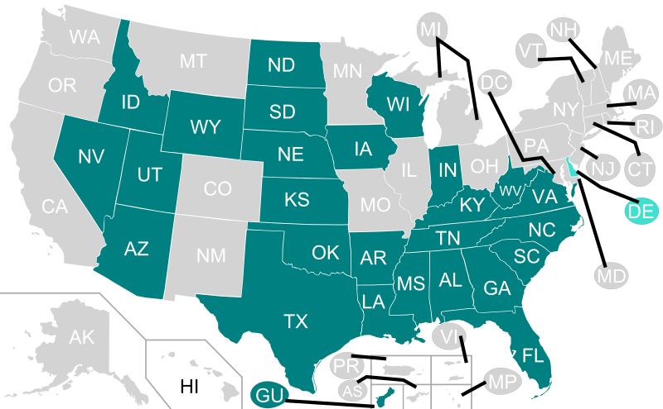
PLAs in Right-to- Work States
PLAs are legal in right-to-work (RTW) states on all private projects.
In the 27 RTW states, workers covered under CBAs are allowed to be free riders: they may choose not to pay agency fees for the costs of services provided by a union.
RTW laws do not make PLAs illegal or impossible. State and local procurement laws may outlaw PLAs.

Slide 16
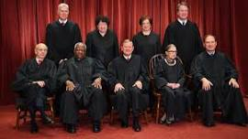
Union Security Clauses in Public CBAs
In 2018, the U.S. Supreme Court ruled in a 5–4 decision that the application of public sector union fees to non-members is a violation of the First Amendment.
Since then, several lawsuits have been filed arguing that a public agency cannot compel the payment of union dues or fees in a public works PLA, even though the workers are not public employees.
NABTU has been proactive and taken the position that any public works PLA, or any PLA that is being required by a public agency, including as a condition of funding, cannot require any worker to pay dues or other monies to a Union (including compliance with a CBA that requires the payment of dues or fees).

Slide 17
NABTU’s Policy on Union Security Clauses in Public PLAs
NABTU’s Policy was adopted unanimously by the Governing Board of Presidents
April 27, 2020 policy letter
May 29, 2020 FAQs
Feb. 11, 2021 Follow-up
All PLAs must be submitted to NABTU for approval.
Public sector PLAs may not contain union security obligations if such obligation is imposed by government.
NABTU will not approve a public sector PLA with a union security obligation.

Slide 18
Union Security Clause on PLAs with Private Entities
Janus v. AFSCME presents issues when a public entity imposes the union security obligation in a PLA or through a bid specification.
There is no potential First Amendment issue if the obligation is solely imposed by a private party.
The question is whether there is sufficient state action (by or on behalf of the public entity) for a potential First Amendment challenge.

Slide 19
PLAs on Federal or Federally-Financed Projects

Slide 20
Use of PLAs on Federal Sites
The Department of Energy contractors have long used PLAs on its sites, including Hanford Site in WA, the Savannah River Site in SC, the Oak Ridge Reservation in TN, the Nevada Test Site, Los Alamos National Laboratory in NM, and the Idaho National Laboratory.
PLAs have been successfully used on TVA sites for more than 3 decades.
National security interest at these sites

Slide 21
President Biden’s Executive Order on PLAs
On February 4, 2022, President Biden issued an Executive Order that mandates PLAs on “large-scale construction projects.”
These include “Federal construction projects,” with a total estimated cost of the construction contract to the Federal Government of $35 million or more.
DoD, GSA, and NASA issued proposed regulations to implement the EO on August 19, 2022, with a 60-day public comment period.
SMART and SMACNA submitted extensive comments.

Slide 22
The Proposed Rule: the Rationale for PLAs
“Large-scale construction” projects often have multiple employers at a single location
A lack of permanent workforce makes it difficult for federal contractors to predict labor costs when bidding on contracts
It is difficult to ensure that a steady supply of labor exists on the contracts being performed
A labor dispute involving one employer can delay the entire project

Slide 23
The Obama EO “Encourages” Use of PLAs
President Obama rescinded a Bush administration EO (2001), which banned the use of PLAs on construction projects undertaken by the Federal Government or with Federal assistance.
The Obama EO states that it is the policy of the Federal Government to “encourage executive agencies to consider requiring” the use of PLAs labor agreements in connection with Federal construction projects valued at $25 million or more
The Obama EO remains in effect until the DoD, GSA, and NASA issue final regulations implementing the Biden EO.

Slide 24
Rare Use of PLAs on Projects with Federal Agencies
Between the years of 2009 and 2021, federal agencies rarely chose to use PLAs on large-scale projects (total cost of $25 million or more).
The OMB estimates that there were a total of about 2,000 eligible contracts. The PLA requirement was used 12 times or 0.6% of eligible projects.

Slide 25
Incentivizing the Use of PLAs
Some federal agencies may have embedded incentives to use PLAs into their notices of funding opportunities (NOFO’s)
Those agencies include the Department of Energy, the Department of Commerce, the General Services Administration, and other key agencies that fund work performed by signatory contractors.

Slide 27
State and Local PLAs

Slide 28
Laws on Use of PLAs on State and Local Public Projects
State and local procurement laws determine whether it is lawful for a state or local contracting agency to enter into a PLA.
These laws are not applicable to federal projects when a federal contracting agency enters into a construction contract.

Slide 29
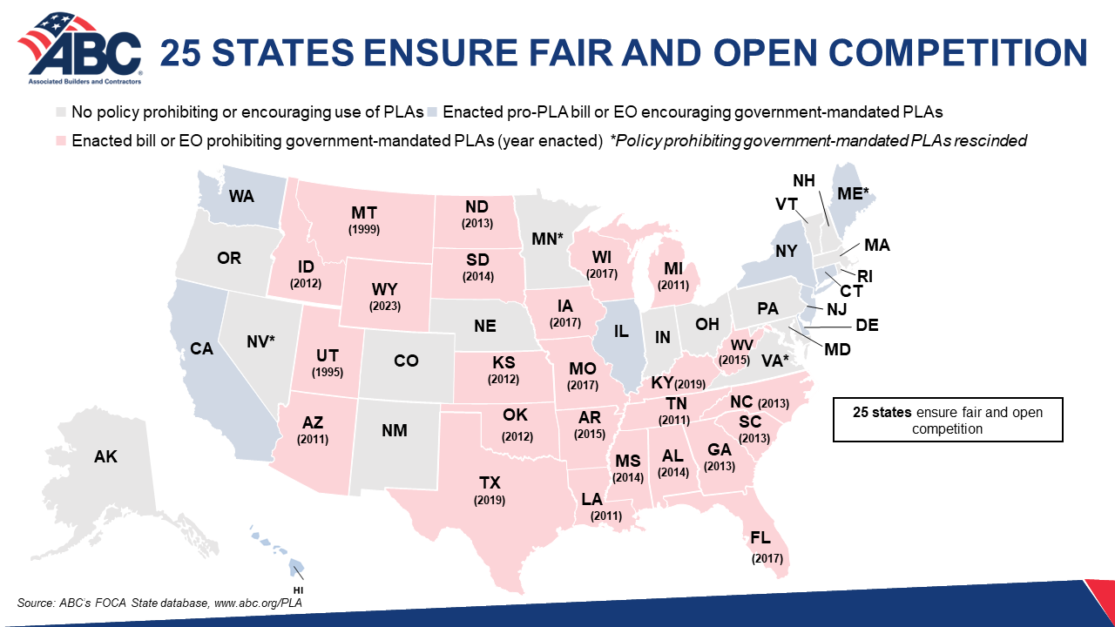

Slide 30
Consult with Local Sources
For the most up-to-date information on state and local legislation against or in support of PLAs in your area, consult with your lobbyist.
Your local attorney can provide information on the state and/or local procurement laws in your area

Slide 31
Questions? You may send your questions to liznadeau@gmail.com or gcollins@felhaber.com

Slide 32
Resources

Slide 33
Obama and Biden Executive Orders on PLAs
Executive Order 13502, Use of Project Labor Agreements for Federal Construction,” 74 Fed. Reg. 33953 (July 14, 2009)
https://www.federalregister.gov/documents/2009/02/11/E9-3113/use-of- project-labor-agreements-for-federal-construction-projects
Executive Order 14063, Use of Project Labor Agreements for Federal Construction Projects, (87 Fed.Reg. 7363, February 9, 2022)
https://www.federalregister.gov/documents/2022/02/09/2022-02869/use-of- project-labor-agreements-for-federal-construction-projects

Slide 34
U.S. Department of Labor
Project Labor Agreement Resource Guide: Project Labor, Community Workforce, and Community Benefits Agreements Resource Guide
https://www.dol.gov/general/good-jobs/project-labor-agreement-resource-guide

